Slide 1
BIOL5124M; Commercialising pharmaceutical products
Dr Richard Tunstall
r.tunstall@leeds.ac.uk

Slide 2

An Introduction
LUBS:
Associate Professor of Enterprise
Section Lead for Help to Grow and KPMG Family Leadership Academy
University::
Academic Director of Enterprise at Leeds
Research Interests
Entrepreneurial Behaviour
Corporate Venturing
Entrepreneurship Education Ecosystems
Nationally & Internationally
Co-Editor IJEBR
Director of Enterprise Educators UK
Visiting Scholar, Babson College USA
@UoL_CEES
@LeedsEnterprise
Cees.leeds.ac.uk

Slide 3


Overall Module aims
provide you with an understanding of the economic drivers across the pharmaceutical industry
explore the role of intellectual property rights in the creation of economic value
examine the exploitation models that can be used to take pharmaceutical products to market
develop your understanding of leadership and team roles within a commercial setting.

Slide 4

Our Focus
develop students’ understanding of leadership and team roles within a commercial setting.
ASSESSMENT
Reflective log
How do I reflect?
Self-assessment tests
How do I control the process?
How do I help others reflect?
How do I apply the concept to work?
Summative essay

Slide 5
Relating back to:
provide students with an understanding of the economic drivers across the biopharmaceutical industry
explore the role of intellectual property rights in the creation of economic value
examine the exploitation models that can be used to take pharmaceutical products to market
Intro
IP
Invention to Opportunity
Drivers & Dimensions of OBM
Presentation
Teamwork
OBM – pulling it together
Licensing

Slide 6
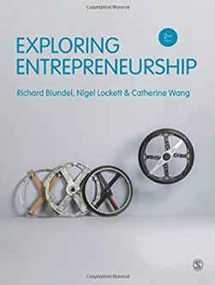
Suggested Reading

Slide 7
Your Group Project….and your Individual Reflection
Networking
Planning
Negotiation
Knowledge
Evaluation
Project Management
Skills
Problem-solving
Mine
BIOL5134M
Others
Attitudes
Self-reliance
Self-confidence
Notes:
Through the elective, should increase knowledge of social enterprise, change attitudes towards this field and the work done by social enterprises, build and develop skills need to develop own social enterprise

Slide 8
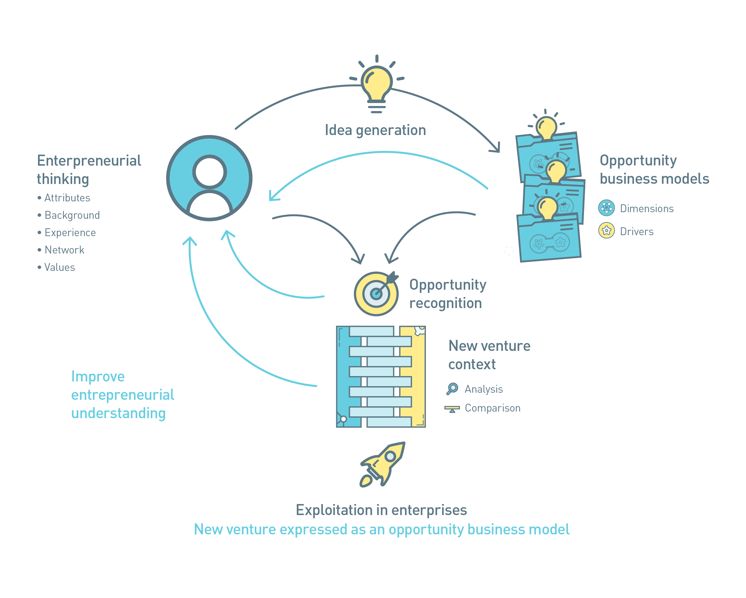
Entrepreneurial learning cycle

Slide 9

Module assessments
Assessment 2 TOTAL = 2,500 words – 70%
Assessment 2 – Part 1; OBM
Presented as an executive summary of 500-750 words, based on group work, but written by you. 5% tolerance.
Brief – see Minerva for full details
This assessment is designed to increase your experience of new venture creation. You will have the opportunity to research a novel pharmaceutical product with emerging intellectual property. The purpose of this assignment is to create a number of potential new business ideas for this product and to work together in your group to express the best idea as an opportunity business model (OBM).

Slide 10
Entrepreneurial opportunities
Do entrepreneurs discover or create opportunities?
Discovery theory versus Creation theory
Opportunities exist all around us and are just waiting be be discovered. Speed is of the essence. Plan before exploitation → causation
Opportunities don’t exist independent of entrepreneurs - they are involved in their creation. Plan as opportunities emerge → effectuation
The more experienced the entrepreneur the more likely to use effectual logic against causal logic

Slide 11

The Land of Opportunity
The Opportunity Business Model is one way to communicate and engage with a different type of audience
Making pharmaceutical science understandable (and exciting)
Within the norms, conventions and language of the commercial environment
“Business models are human creations, just as technology is. So we innovate the heck out of technology. Well let’s do it with business models too” (Victoria Hale)
illustration by Doug Chayka

Slide 12
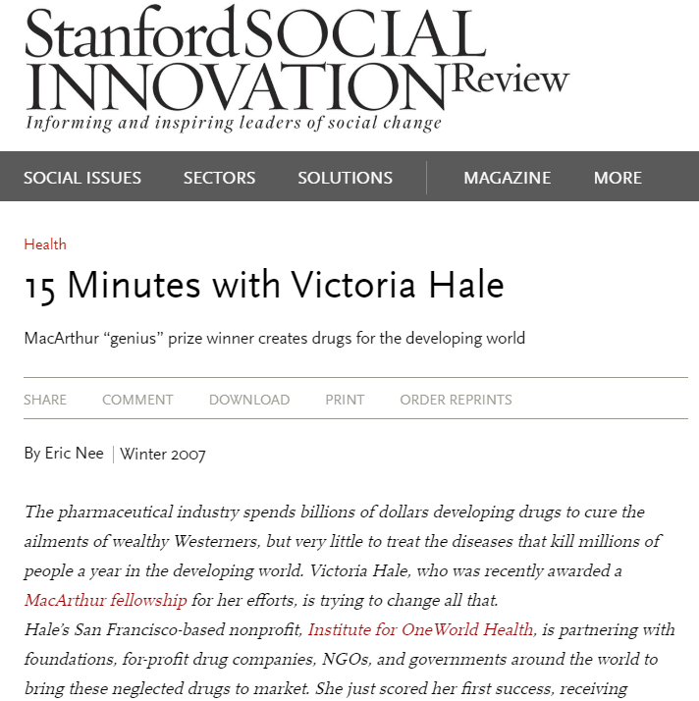
https://ssir.org/articles/entry/15_minutes_with_victoria_hale
Why is opportunity business modelling important?
Notes:
https://ssir.org/articles/entry/15_minutes_with_victoria_hale
Why is opportunity business modelling important?

Slide 13

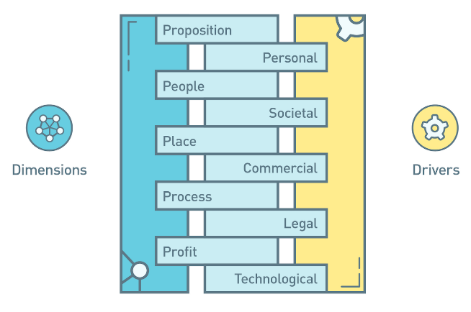
Opportunity business model
Blundel, R., & Lockett, N. (2011). Exploring Entrepreneurship. Oxford University Press.

Slide 14
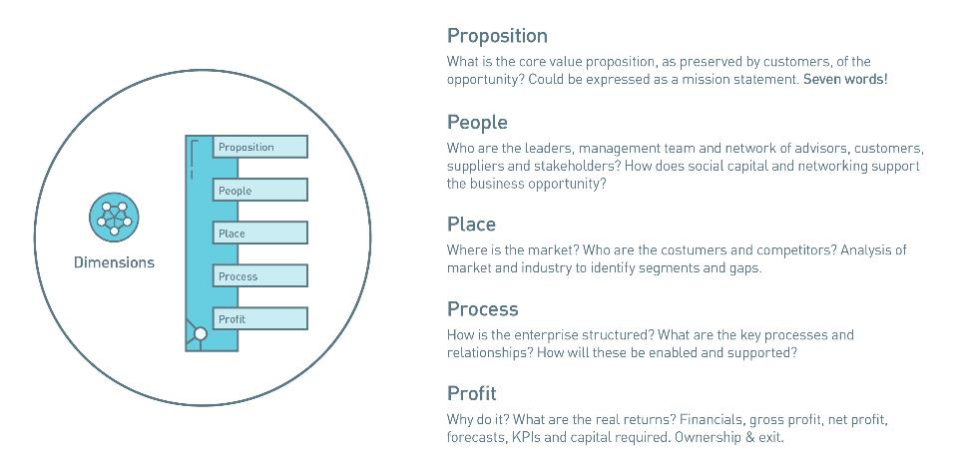
OBM: Dimensions (Internal)

Slide 15
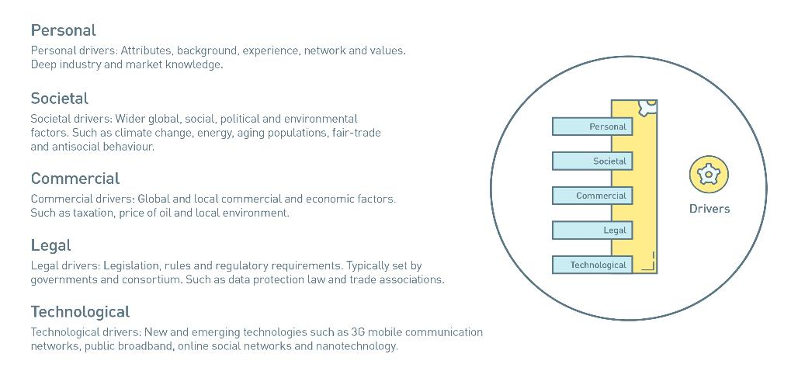
OBM: Drivers (External)

Slide 16
Opportunity BM Context
Customers
Competitors
Markets are made-up of customers (or potential) who buy products and services. Analysis of the market conditions in order to identify customer segments and compare with industry gaps to identify exploitable opportunities.
Industry is made-up of competitors who supply products and services. Analysis of the industry attractiveness in order to identify gaps and compare with market segments to identify exploitable opportunities.
Market analysis
Industry analysis
Market
Industry
Segmentation
Gap

Slide 17
Example: Industry Challenges
Rising customer expectations: The commercial environment is getting harsher, as healthcare payers impose new cost constraints on healthcare providers and scrutinise the value medicines offer much more carefully. They want new therapies that are clinically and economically better than the existing alternatives, together with hard, real-world outcomes data to back any claims about a medicine’s superiority.
Poor scientific productivity: Pharma’s output has remained at a stable level for the past decade. Using the same discovering and developing processes, there’s little reason to think its productivity will suddenly soar.
Cultural sclerosis: The prevailing management culture, mental models and strategies on which the industry relies are the same ones it’s traditionally relied on, even though they’ve been eclipsed by new ways of doing business.
Source: https://www.pwc.com/gx/en/industries/pharmaceuticals-life-sciences/publications/pharma-2020.html
Notes:
PwC believes that seven major trends are reshaping the marketplace:
Instances of chronic disease are increasing
Healthcare policy-makers and payers are increasingly mandating what doctors can prescribe
A growing number of healthcare payers are measuring the pharmacoeconomic performance of different medicines.
Boundaries between different forms of healthcare are blurring, as clinical advances render previously fatal diseases chronic and the self-medication sector expands
Demand for medicines is growing more rapidly in the emerging economies than the industrialized economies
Governments are beginning to focus on prevention rather than treatment, although they have not yet invested very much in pre-emptive measures; and
Regulators are becoming more cautious about approving truly innovative medicines.
These trends will compound the challenges Pharma already faces, but they’ll also provide some major opportunities.

Slide 18
Example: Industry Challenges
The global pharmaceutical market forecast to be worth $1.6 trillion
Demand for medicines is rising rapidly in the growth markets
The middle class is expanding
Big pharma’s using four strategies in the growth markets
New forms of medical intervention are in the pipeline
The context in which pharma operations has changed dramatically
Source: https://www.pwc.com/gx/en/industries/pharmaceuticals-life-sciences/publications/pharma-2020.html
Notes:
PwC believes that seven major trends are reshaping the marketplace:
Instances of chronic disease are increasing
Healthcare policy-makers and payers are increasingly mandating what doctors can prescribe
A growing number of healthcare payers are measuring the pharmacoeconomic performance of different medicines.
Boundaries between different forms of healthcare are blurring, as clinical advances render previously fatal diseases chronic and the self-medication sector expands
Demand for medicines is growing more rapidly in the emerging economies than the industrialized economies
Governments are beginning to focus on prevention rather than treatment, although they have not yet invested very much in pre-emptive measures; and
Regulators are becoming more cautious about approving truly innovative medicines.
These trends will compound the challenges Pharma already faces, but they’ll also provide some major opportunities.

Slide 19
Key Trends
Evolving clinical trials
Determine the right studies for new models
Weigh the costs and savings of new trials
Address consumer concerns
Increase participant diversity
Developing supply chain resiliency
Consider supply localisation
Build partnerships
Invest in the workforce of the future
Advances in virtual clinical care
Protect against inequalities
Address health data privacy & security
Manage for change
Harnessing data analytics
Leverage data to target interventions
Convene regional collaborations
Develop a data driven culture
https://www.pwc.com/gx/en/industries/healthcare/top-health-industry-issues.html
Notes:
Advances in virtual clinical care
Protect against inequalities
Harnessing data analytics
Evolving clinical trials
Developing supply chain resiliency

Slide 20
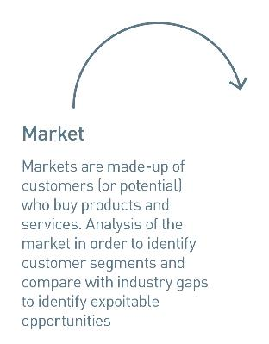
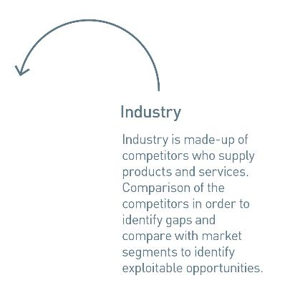
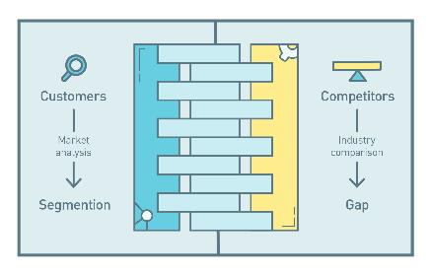
OBM: Bringing it together
OBM Context
Blundel, R., & Lockett, N. (2011). Exploring Entrepreneurship. Oxford University Press.

Slide 21

Reflections

Slide 22

Module assessments
Assessment 2 TOTAL = 2,500 words – 70%
Assessment 2 – Part 2; reflective essay
Based on reflective journal entries (as evidence), 1750-2000 words long (depending on OBM Executive Summary) 5% tolerance
Throughout the module, you will need to write weekly journals; commenting reflectively on the activities you have undertaken each week.
You will be given a personal area on Minerva
At the end of the module, write a summative essay that uses the weekly journal entries as evidence of knowledge, skill and attitude development.
Notes:
This module is inherently ‘problem-based’ learning > even more, we present you with a “wicked problem”, which means that as you begin to solve one problem, it uncovers more underneath > the OBM is essentially a measure of the outcomes for your work together as a group > this assessment is the evidence of a journey
We know that reflection is an attribute of high-performing individuals and it is a skill that can be mastered. There are stages of skill development mapped out for you in the VLE. You should write an entry each week following through the different stages as you go.

Slide 23
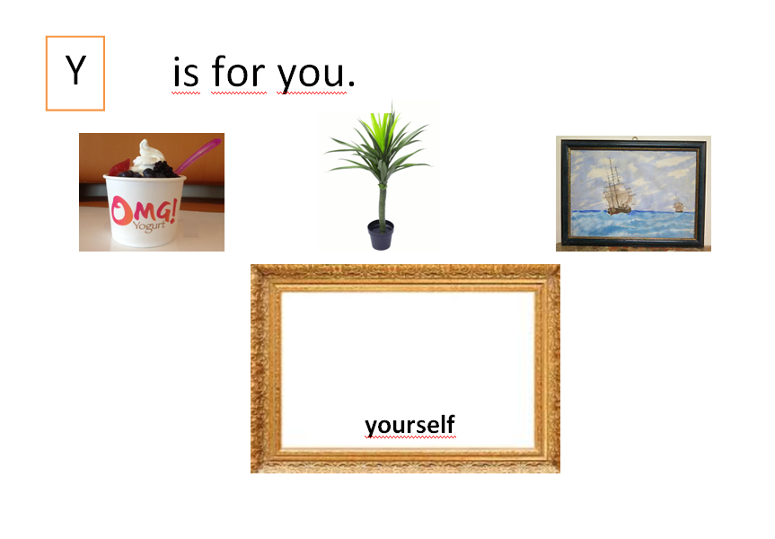

Slide 24

Management Reflection
Reflection is a key managerial mind-set Mintzberg (2004),
Translation between management experience into learning (Seibert & Daudelin, 1999),
The literature on Reflective teaching practice is introduced by Dewey (1933).

Slide 25
How do I reflect?
Reflection is a skill that, like other skills, can be mastered.
Questions provided every OBM lecture. For each of your journal entries, you should follow a similar pattern for your answer:
Describe an experience (what happened?) >
Reflect (How did you react to this? how did you feel? what thoughts did you have? what did you learn?) >
Explain your reaction (How did the experience match with your preconceived ideas of what would happen?) >
Hypothesise (What could you have done differently to change the outcome? what would you do differently in the future?)

Slide 26
How do I reflect?
Reflection is a skill that, like other skills, can be mastered.
PLAN your weekly entry:
1) Do you make time for reflection? Is this a concious decision? Do you have periods in the day when you are most likely to be reflecting e.g. as you go to bed, in the shower, on your way into University?
2) Do you clear mental space for reflection? Are you relaxed? Breathing slowly, sitting calmly and blocking out noise/distractions are important components of reflection.
3) Do you focus on overly negative or positive aspects of your experiences when reflecting? Do you accept that the events occurred as they did or replay them with different outcomes? Try to consciously challenging your behaviour, thoughts and beliefs without anxiety but as an observer of yourself (heightened self-awareness).

Slide 27
How to reflect?
Don’t just describe what happened
Do be honest
Do be critical
Do consider your experience in the light of the theories about entrepreneurship, teams, leadership etc.

Slide 28
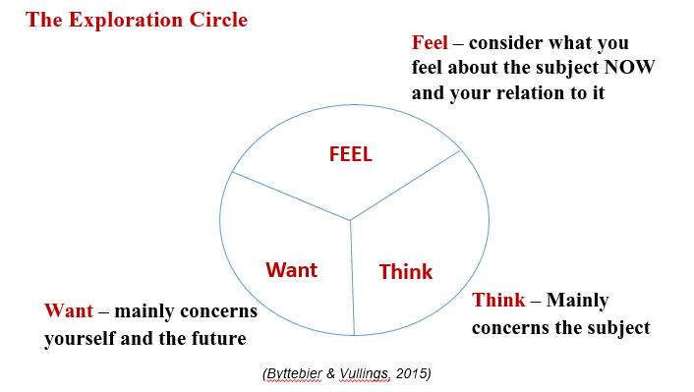
The Exploration Circle

Slide 29
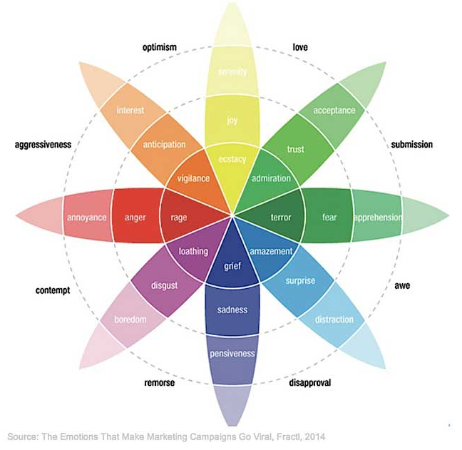
EMOTIONS in Reflection - Plutchik’s three dimentional model
8 Primary emotion dimensions (anger, anticipation, joy, trust, fear, surprise, sadness & disgust),
Intensity: emotions intensity as they move from the outside to the center of the wheel,
Relations: each circle sector has an opposite emotion.

Slide 30
Writing your Reflective Journal Entries – Critical vs Descriptive
Descriptive Writing | Critical Writing
States what happened | Identifies the significance
States what something is like | Judges strengths and weaknesses
Gives the story so far | Weighs one piece of information against another
States the order in which things happen | Makes reasoned judgments
Says how to do something | Argues a case according to evidence
Explains what a theory says | Shows why something is relevant or suitable
Says when something occurred | Identifies why timing is important
States options | Gives reasons for selecting each option
Lists details | Evaluates the relative significance of details
Lists in any order | Structures information in order of importance
States links between items | Shows relevance of links between pieces of information

Slide 31
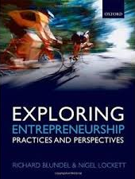
Tasks for This Week
Tasks
Have a look through the ‘Weekly Reflective Journal’ area on Minerva (in Learning Resources: Assignment 3 – reflective essay)
Consider “How you reflect”
Write in your reflective logs about this week’s session
Start to research the technology presented to you this week and consider what new opportunities could be exploited. Try conducting some initial research on these – FT.com?
Points for reflection in your log
What do you hope to achieve from being part of this module?
How do you feel about embarking on this project?
What are you thoughts on the changing nature of the pharmaceutical industry? What are the challenges and opportunities?
Further reading
Chapter 1
Blundel, R., & Lockett, N.
(2011).
Exploring
Entrepreneurship.
Oxford University Press.

Slide 32
References
Blundel, R., Lockett, N. and Wang, C. 2018. Exploring Entrepreneurship. Sage
Crossan, M.; Lane, H.; White, R. 1999. An organisational learning framework: From intuition to institution. Academy of Management, 24, 522–537.
Dewey, J. (1933). How we think: A restatement of the relation of reflective thinking to the educative process. New York: D.C. Heath and Company.
Hilden, S. and Tikkamäki, K. (2013). Reflective Practice as a Fuel for Organizational Learning. Adminitrative Sciences. 3:76-95
Mintzberg and J.A. Waters, ‘Of strategies, deliberate and emergent’, Strategic Management Journal, vol. 6, no. 3 (1985), p. 258.
PwC Pharma 2020: from vision to decision Available at https://www.pwc.com/gx/en/industries/pharmaceuticals-life-sciences/publications/pharma-2020.html accessed 21th January 2020
Reflective Writing Available at https://www.youtube.com/watch?v=QoI67VeE3ds Accessed on 28th January 2020
Spalding, E. & Wilson, A. (2002). ‘Demystifying reflection: A study of pedagogical strategies that encourage reflective journal writing.’ Teachers College Record, 104, 1393-1421.
University of Reading (na) Practice-based and reflective learning. Available at https://libguides.reading.ac.uk/reflective/thinking accessed 28th January 2020

